Slide 1
Spring Boot
Pet Park Locations: Global error handler

Slide 2
In this video...
How to gracefully handle errors (theory)
How to gracefully handle errors (code)

Slide 3
The problem
What happens when we add another contributor with the same email as an existing one?
We get an unhelpful java.sql.SQLIntegrityConstraint-ViolationException
We need to parse the exception message to see that it is a duplicate key exception (that's bad)

Slide 4
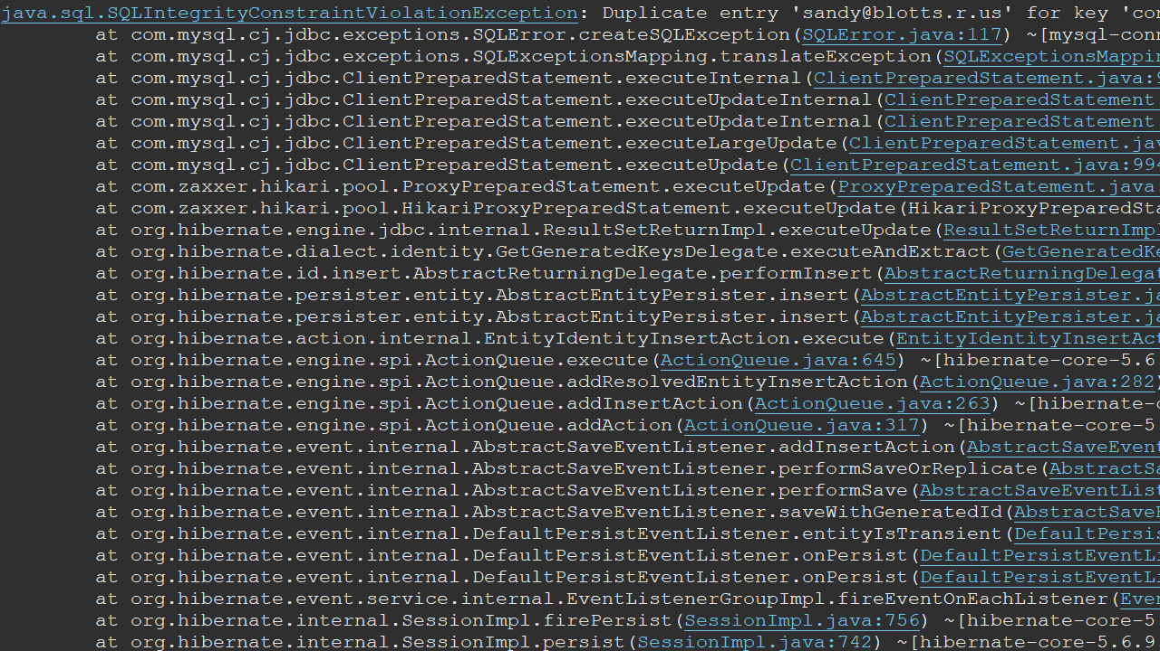

Slide 5
Why is this a problem?
Spring returns a 500 status (Internal Server Error) for any unhandled exception
The real status should be 409 (Conflict)
We can fix this by throwing a more specific exception and handling it in a global error handler

Slide 6
The solution
class ParkService {
public saveContributor(...) {
if(contributor email exists) {
throw new DuplicateKeyException()
}
}
}
@RestControllerAdvice
class GlobalErrorHandler {
@ExceptionHandler(
DuplicateKeyException)
public ... handleErr() {
}
}

Slide 7
In the code...
Throw DuplicateKeyException if contributor already exists
Throw NoSuchElementException if contributor not found
Create global error handler to manage the exceptions

Slide 8
Let's code it!

